Slide 1







DBMS
Lab-6

Slide 2
Things we will complete today
User management and Authorization
SQL Join Expressions

Slide 3
SQL Join operations
Notes:
https://www.studytonight.com/dbms/joining-in-sql.php

Slide 4



The Natural Join
To make the life of an SQL programmer easier for this common case, SQL supports an operation called the natural join

Slide 5
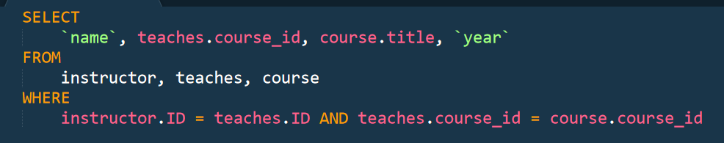
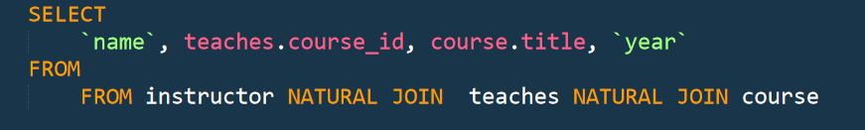
The Natural Join
To make the life of an SQL programmer easier for this common case, SQL supports an operation called the natural join

Slide 6
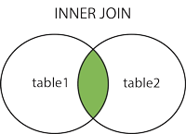
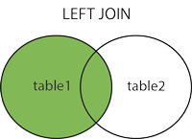
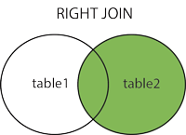
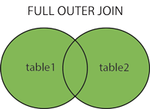
Other Join expressions
(INNER) JOIN: Returns records that have matching values in both tables
LEFT (OUTER) JOIN: Returns all records from the left table, and the matched records from the right table
RIGHT (OUTER) JOIN: Returns all records from the right table, and the matched records from the left table
FULL (OUTER) JOIN: Returns all records when there is a match in either left or right table

Slide 7
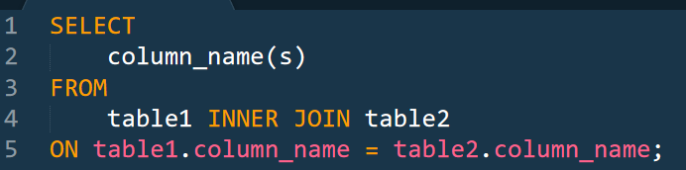
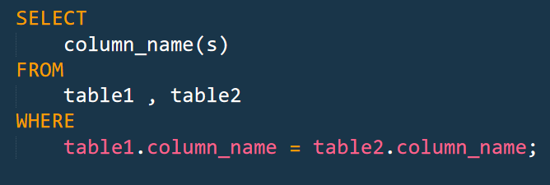
The INNER JOIN Keyword
The INNER JOIN keyword selects records that have matching values in both tables.

Slide 8
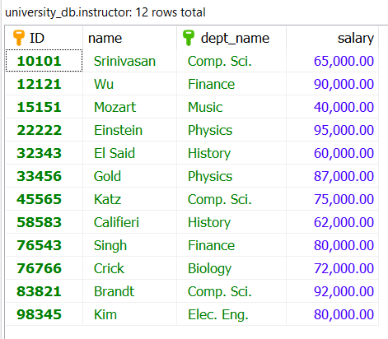
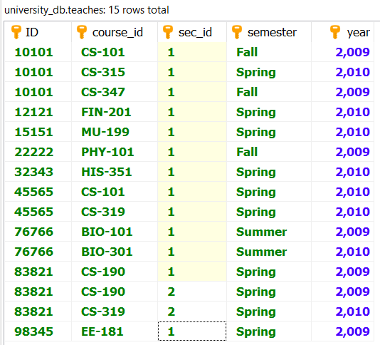
The INNER JOIN Keyword

Slide 9
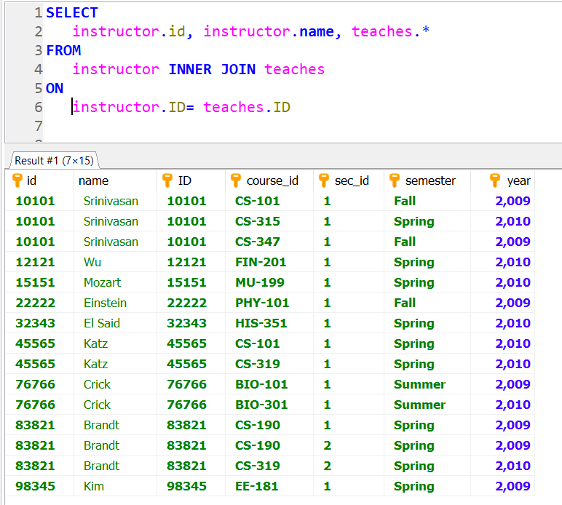
The INNER JOIN Keyword

Slide 10
The LEFT JOIN Keyword

Slide 11
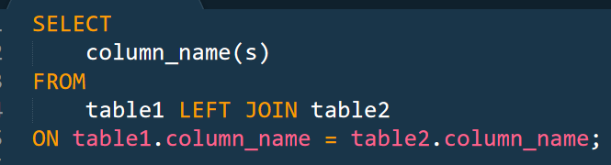
The LEFT JOIN Keyword
The LEFT JOIN keyword returns all records from the left table (table1), and the matched records from the right table (table2). The result is NULL from the right side, if there is no match.

Slide 12
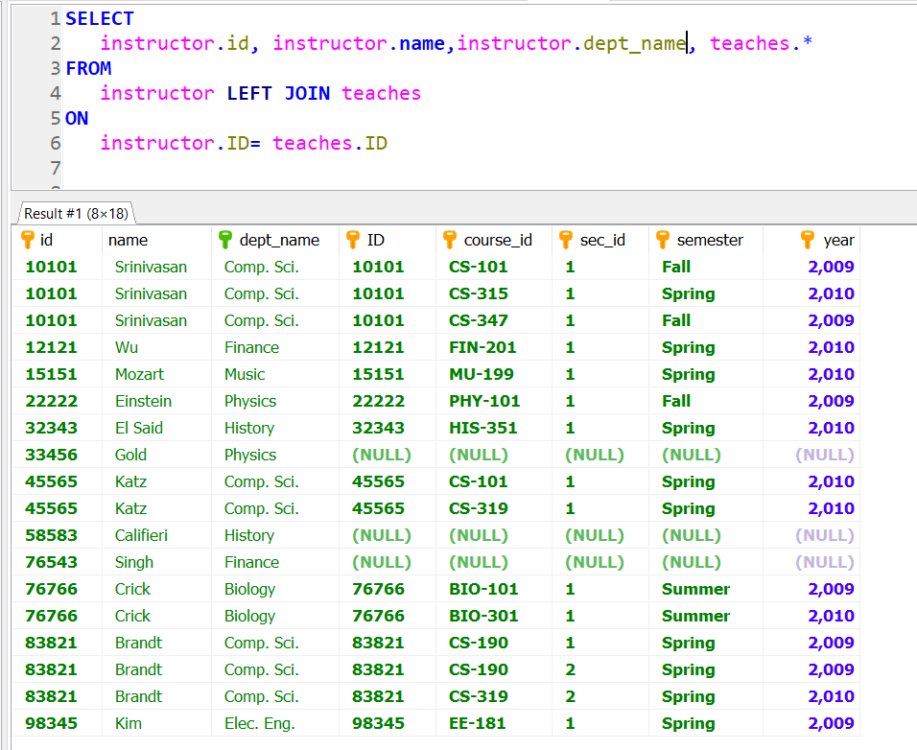
The LEFT JOIN Keyword

Slide 13
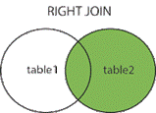
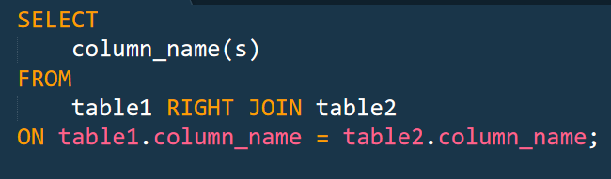
The RIGHT JOIN Keyword
RIGHT (OUTER) JOIN Returns all records from the right table, and the matched records from the left table

Slide 14
The INNER JOIN Keyword

Slide 15
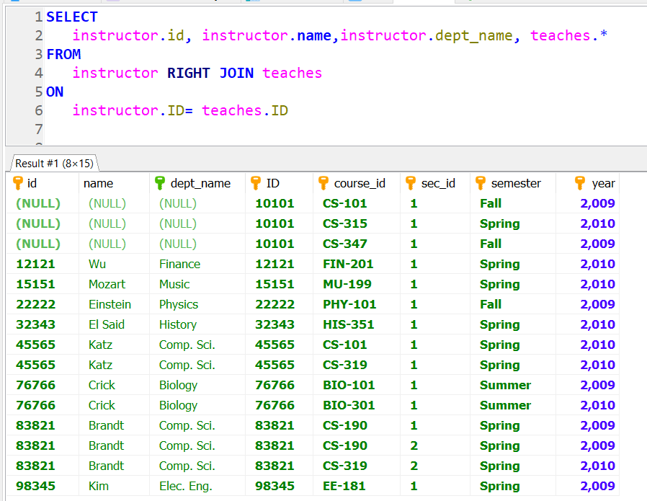
The RIGHT JOIN Keyword

Slide 16
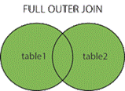
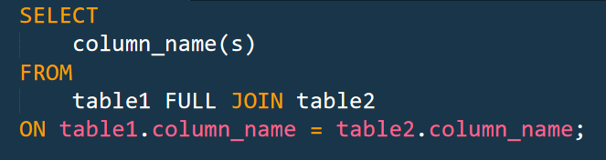
The FULL JOIN Keyword
FULL (OUTER) JOIN Returns all records when there is a match in either left or right table
Supported in MS SQL Server, Oracle
Not supported in MySQL.

Slide 17
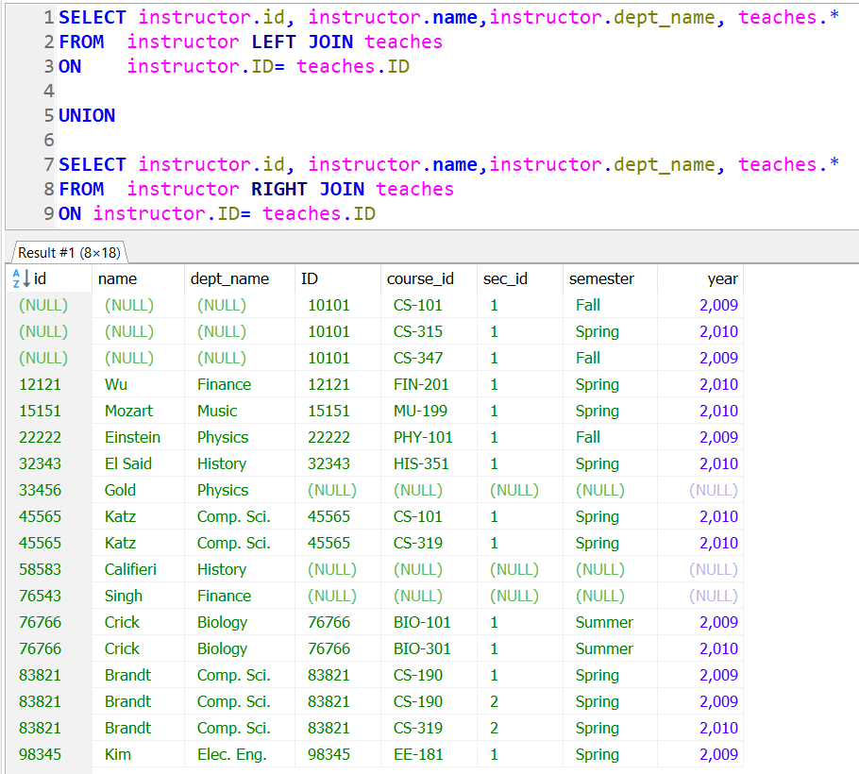
The FULL JOIN Alternative in MySQL

Slide 18
User Management and Privileges
Notes:
https://www.studytonight.com/dbms/joining-in-sql.php

Slide 19
Create a MySQL User

Slide 20
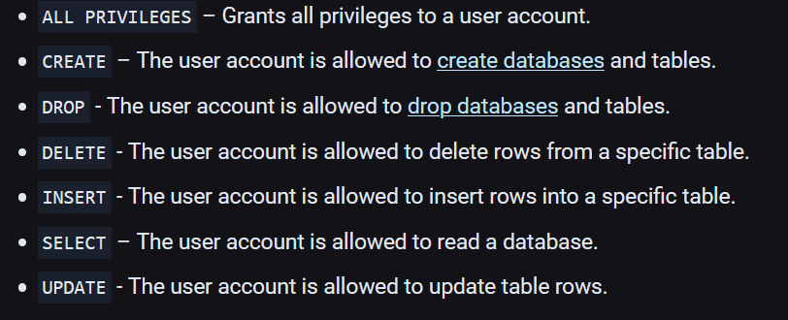
Grant Privileges to a MySQL User Account
There are multiple types of privileges that can be granted to a user account. The most commonly used privileges are:

Slide 21
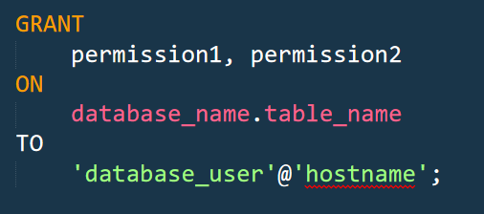
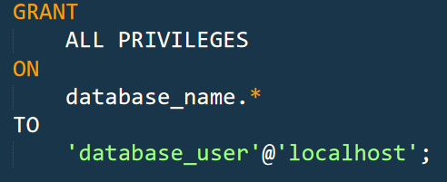
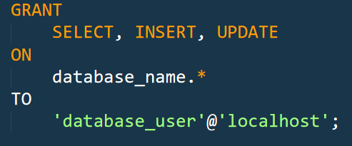
Grant Privileges to a MySQL User Account

Slide 22
Demo.

Slide 23
End.

